Slide 1
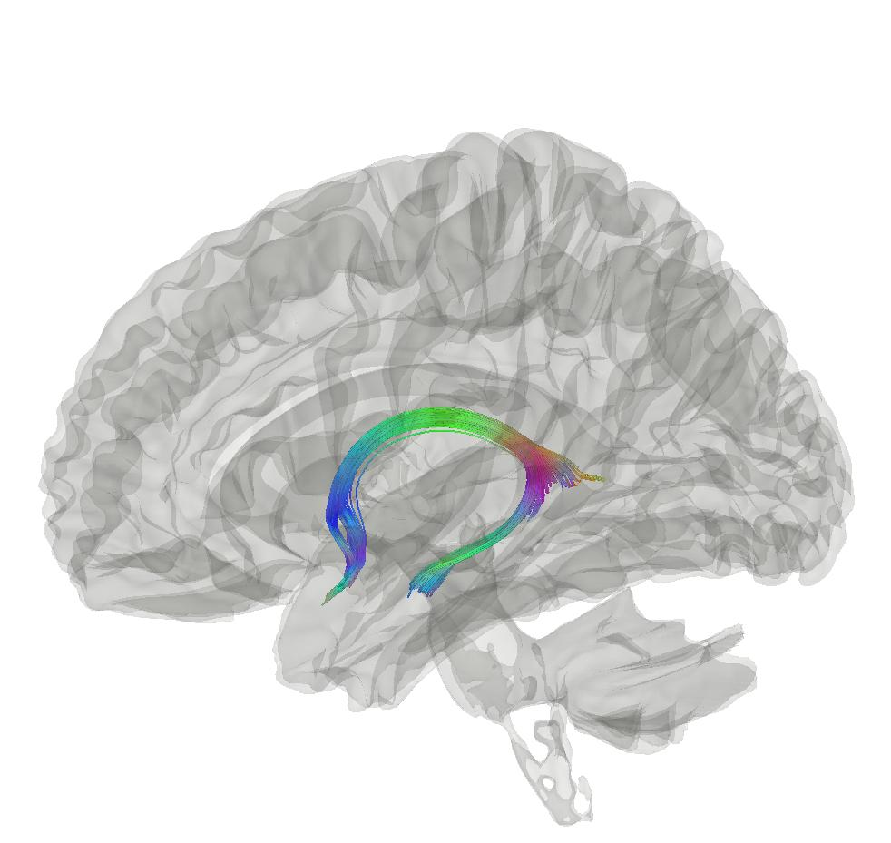



Magnetic Resonance Imaging Ageing Biomarkers
Max Korbmacher
Western Norway University of Applied Sciences, Bergen
Email: Max.Korbmacher@hvl.no
Twitter: @KorbmacherMax

Slide 2
What I will talk about today
Concepts
Results
Conclusions
PART I: CONCEPTS
A normative understanding of ageing
Brain age
PART II: RESULTS
Samples
White matter ageing
Putting brain age to the test
PART III: CONCLUSIONS

Slide 3
1. CONCEPTS

Slide 4
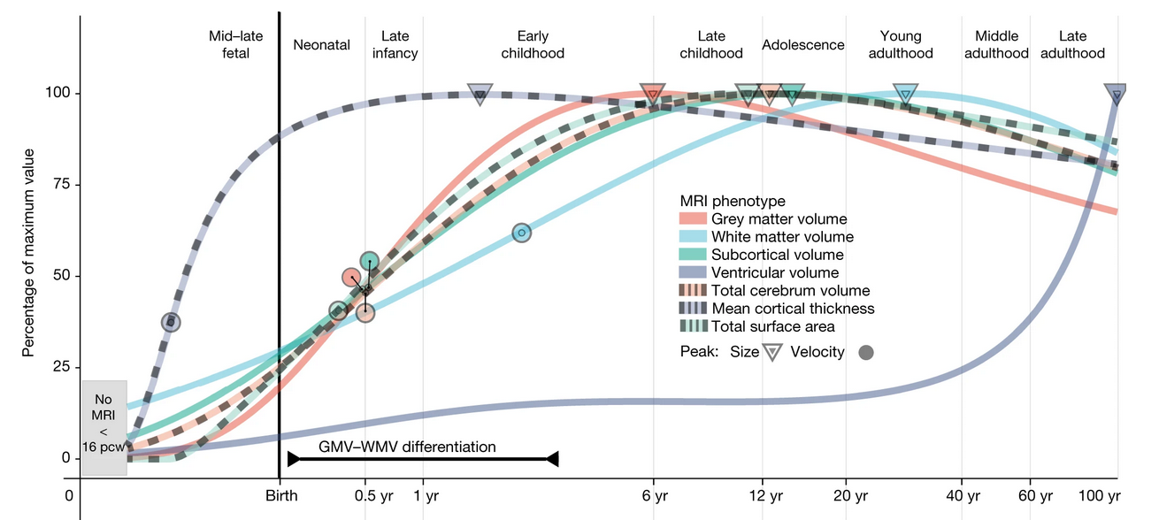
1. Ageing as a normative process
Concepts
Results
Conclusions
There are normative patterns of brain tissue development throughout the lifespan
Non-normativ development can indicate illness and symptom development¹
Establishing normative patterns requires big data²
1 Rutherford et al., 2022, Elife, 11; 2 Marek et al., 2022, Nat., 603(7902)

Slide 5
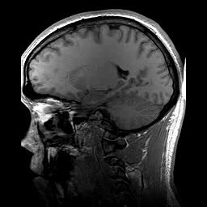
2. Brain age
Concepts
Results
Conclusions
Brain age gap (BAG) calculation
Train a model from MR data
Do age predicitons for each individual: “Your brain is X years old”
Calculate the difference between chronological and predicted age
BAG associations
Related with a whole bunch of phenotypes, clinical symptoms and diagnoses¹
Larger in several clinical groups vs controls¹
Chronologically 22 years old
Age prediction
Biologically 28 years old
BAG = 6 years
1 Franke & Gaser, 2019, Front. Neurol., 789

Slide 6
3. Ways to go in identifying MRI biomarkers
Concepts
Results
Conclusions
In case of my project:
Start with “healthy controls”
Identify brain regions of interest
Test brain age utility

Slide 7
2. RESULTS

Slide 8

0. Samples: “healthy controls”
Concepts
Results
Conclusions
Going big
UKB MRI: cross-sectional N ~ 50k, longitudinal N ~ 5k
Oslo data: N = 1,065
Going small
Bergen data: N = 3, M = 103
Germany data: N = 1, M = 557

Slide 9
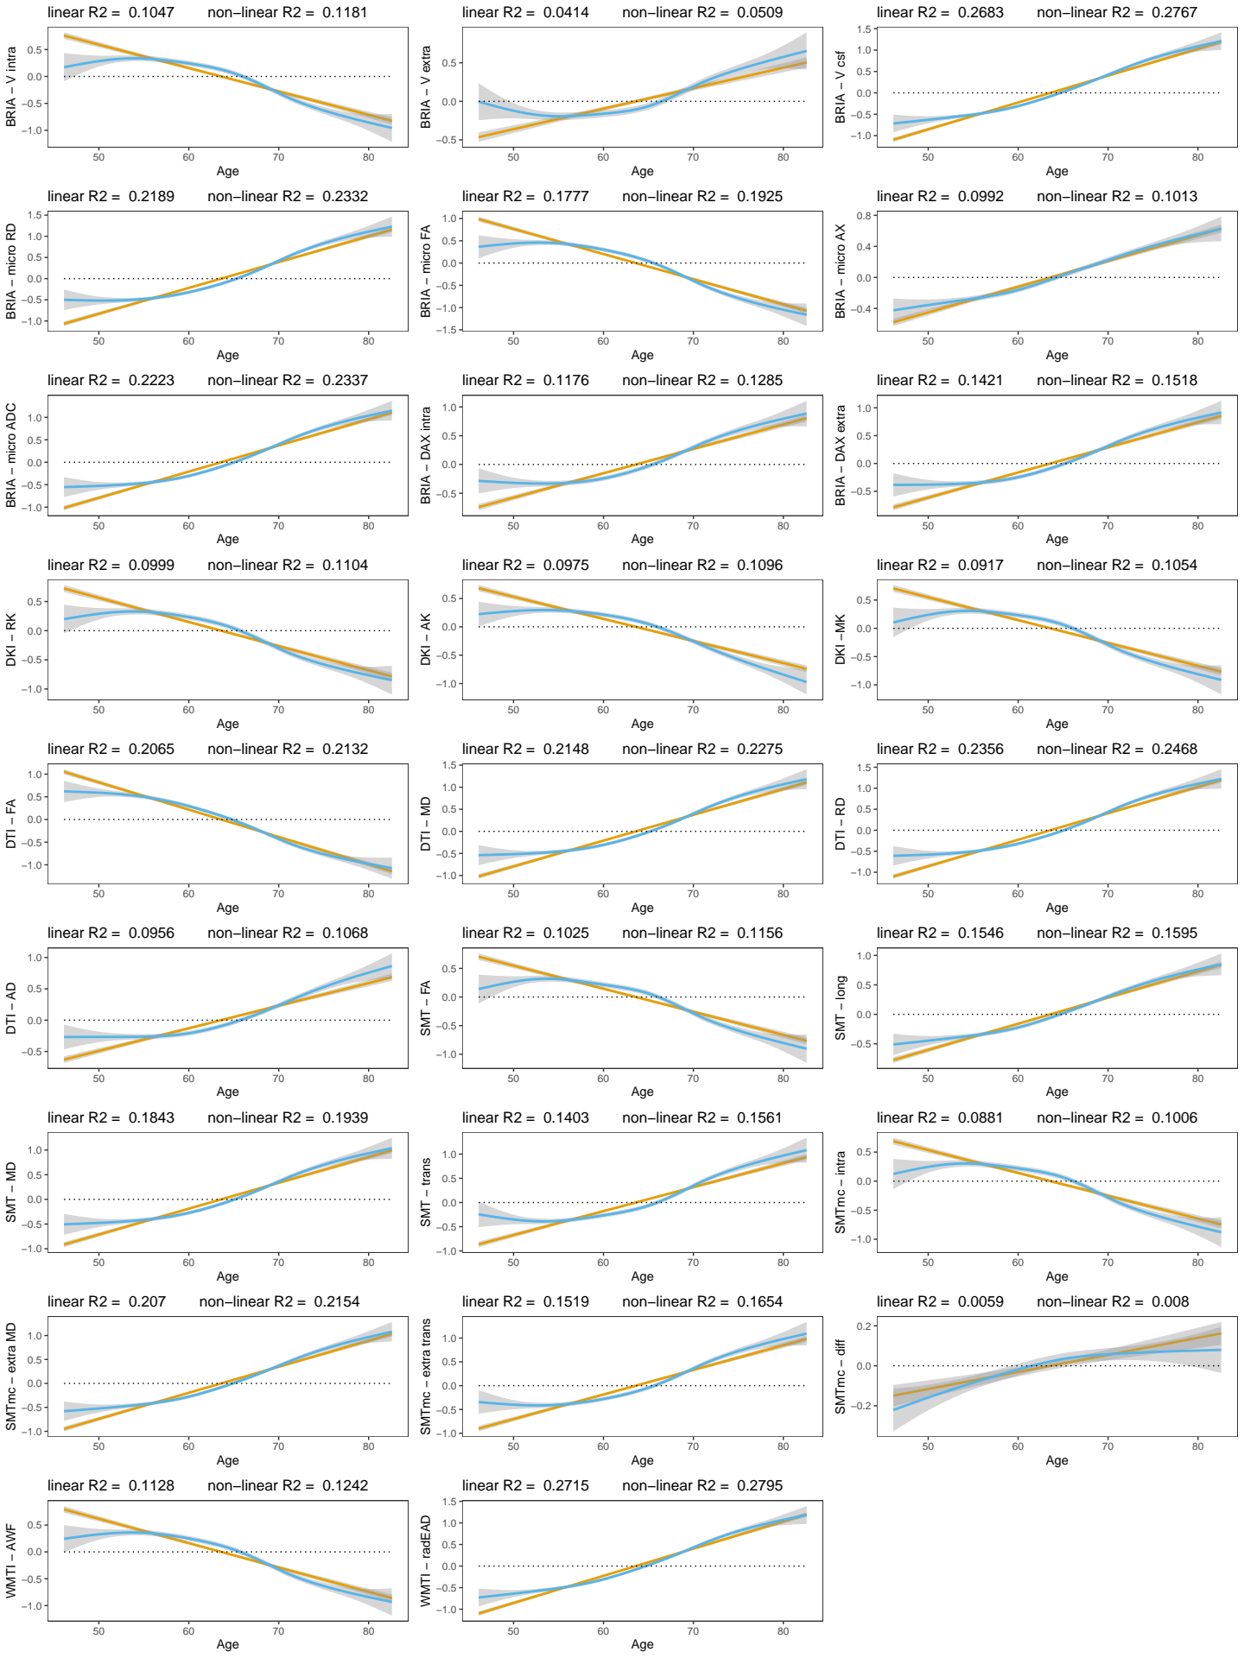
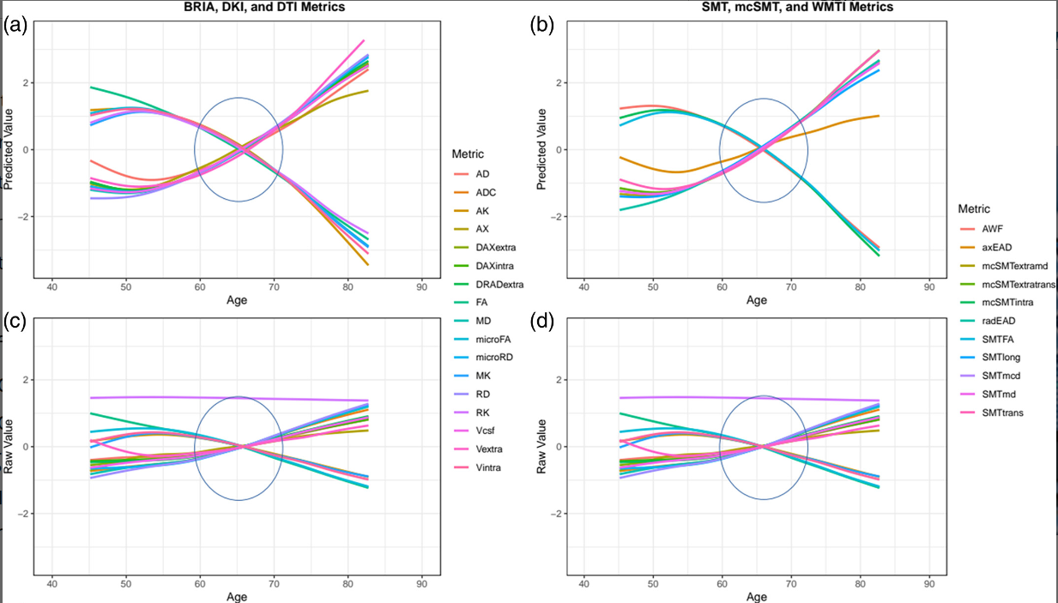
1. Global trends of white matter ageing
Concepts
Results
Conclusions
There are general trends of WM ageing across metrics (helps explain dMRI)
([left] cross sectional¹ & [right] longitudinal²)
1 Korbmacher et al., 2023, Hum. Brain Map. 44(10), 2 Korbmacher et al., 2023 in prep.

Slide 10
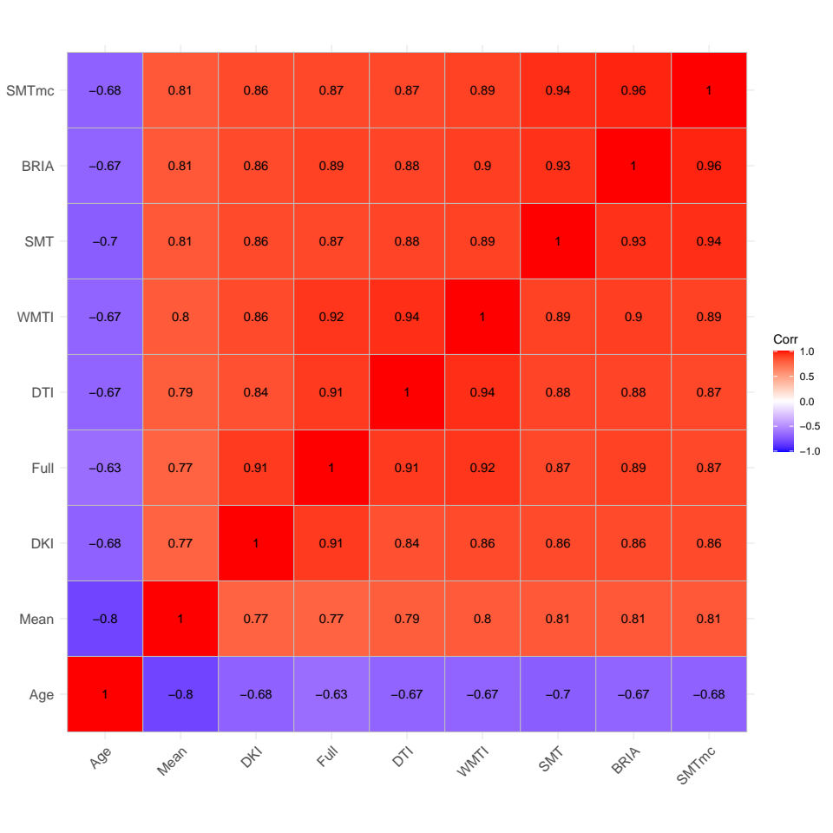
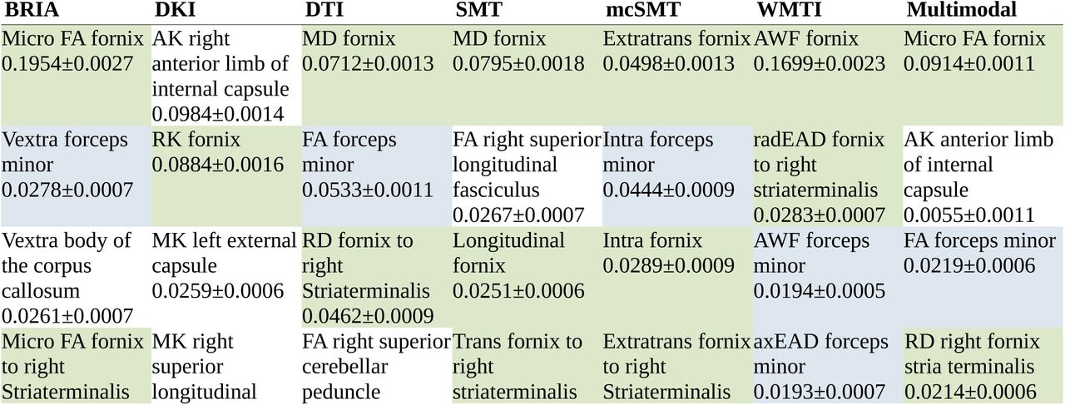
1. Regional trends of WM ageing
Concepts
Results
Conclusions
Brain age estimates (using XGB on tabular data) similar across diffusion approaches (DTI, DKI, …)
Most important features for brain age predictios: fornix & forceps minor¹
1 Korbmacher et al., 2023, Hum. Brain Map. 44(10)

Slide 11
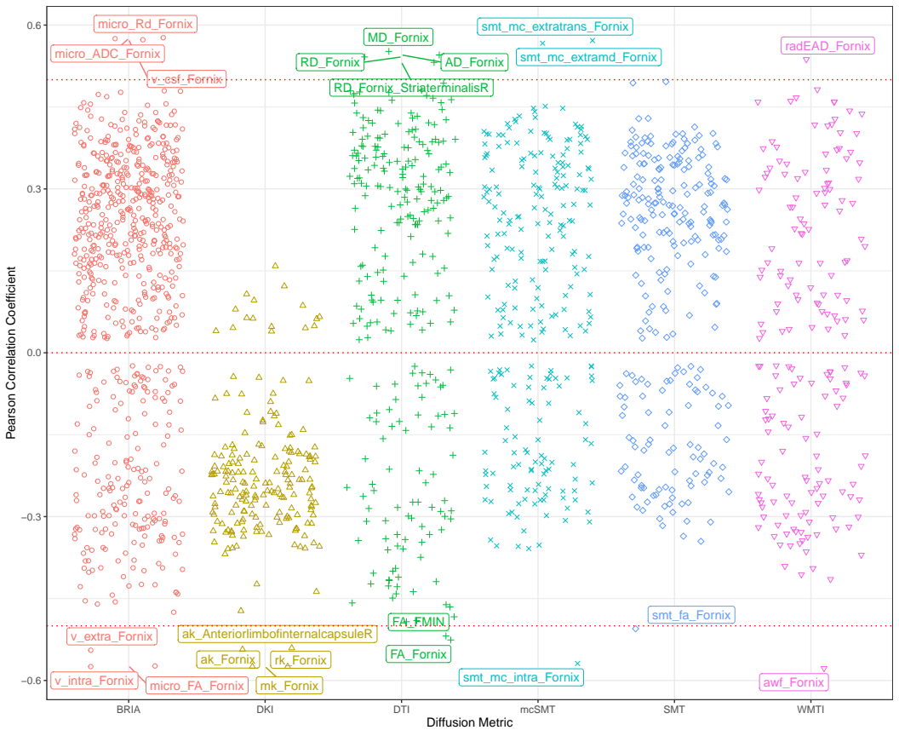
1. Regional trends of WM ageing
Concepts
Results
Conclusions
Strong crude fornix WM microstructure-age relationships underline feature importance findings
Korbmacher et al., 2023, Hum. Brain Map. 44(10)

Slide 12
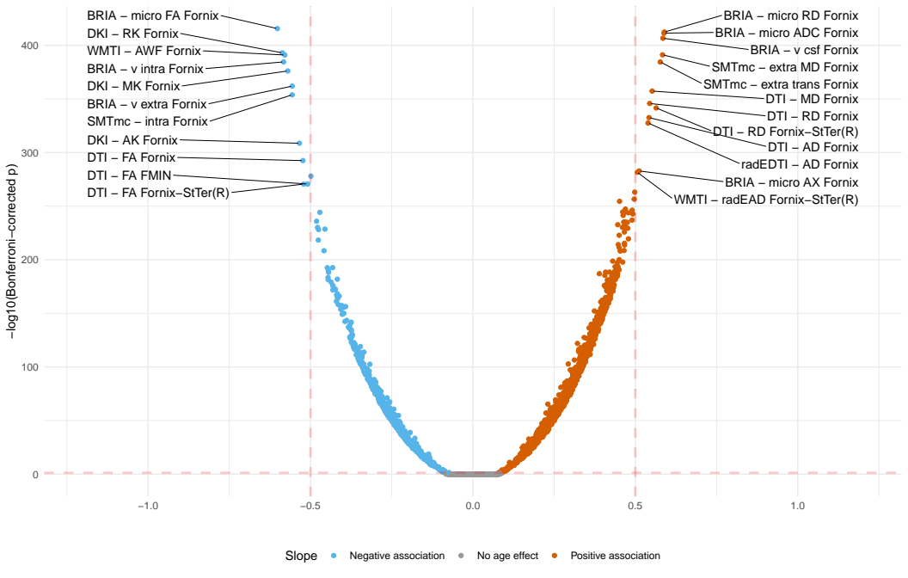
1. Regional trends of WM ageing
Concepts
Results
Conclusions
Longitudinal age-associations outline fornix as well (with directionality in trends being similar to global findings)
Adjusted age-white matter relationships, StTer = stria terminalis

Slide 13
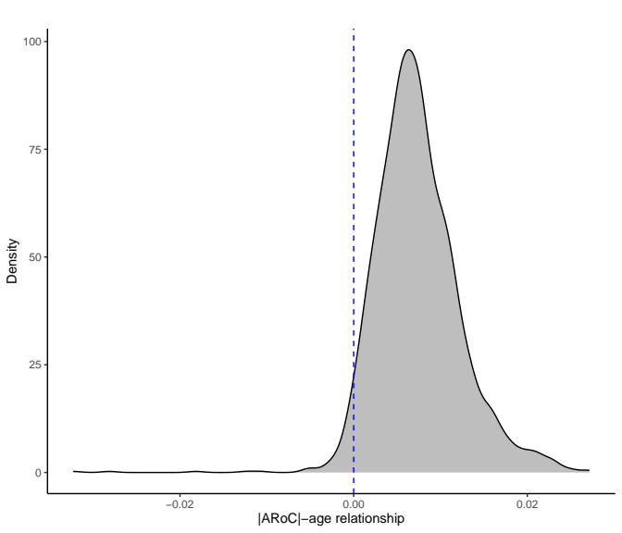
1. Practical implications? Polygenic risk-WM associations
Concepts
Results
Conclusions
Cerebellar peduncle metrics shows strongest genetic risk associations, not fornix
Effects were non-sign. due to small effect sizes (β < 0.1)
(despite sufficient statistial power, N ~ 3k, M = 2)
Still clinically meaningful?

Slide 14
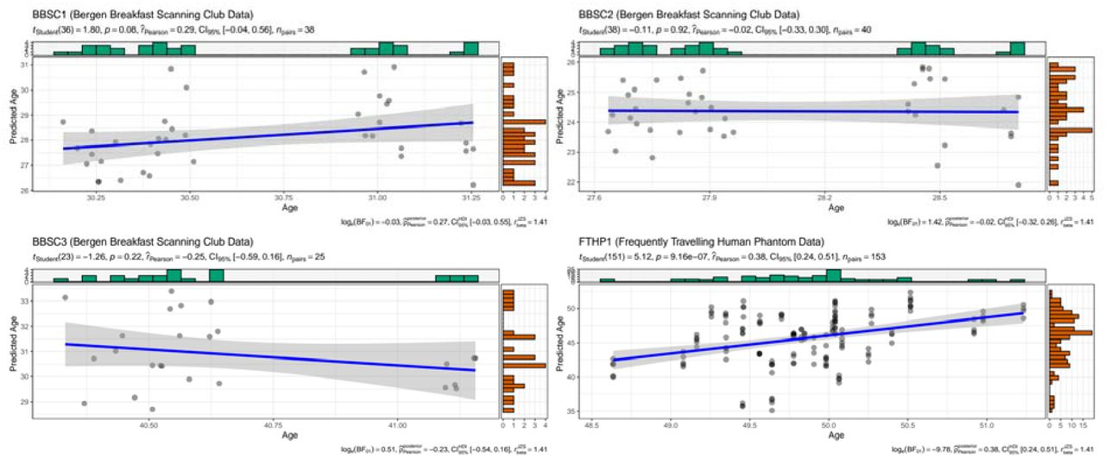
2. Putting brain age to the test
Concepts
Results
Conclusions
Label-prediction correspondance was not too great
Too short inter-scan interval?
Korbmacher et al., 2023, Brain & Beh. (in press)

Slide 15
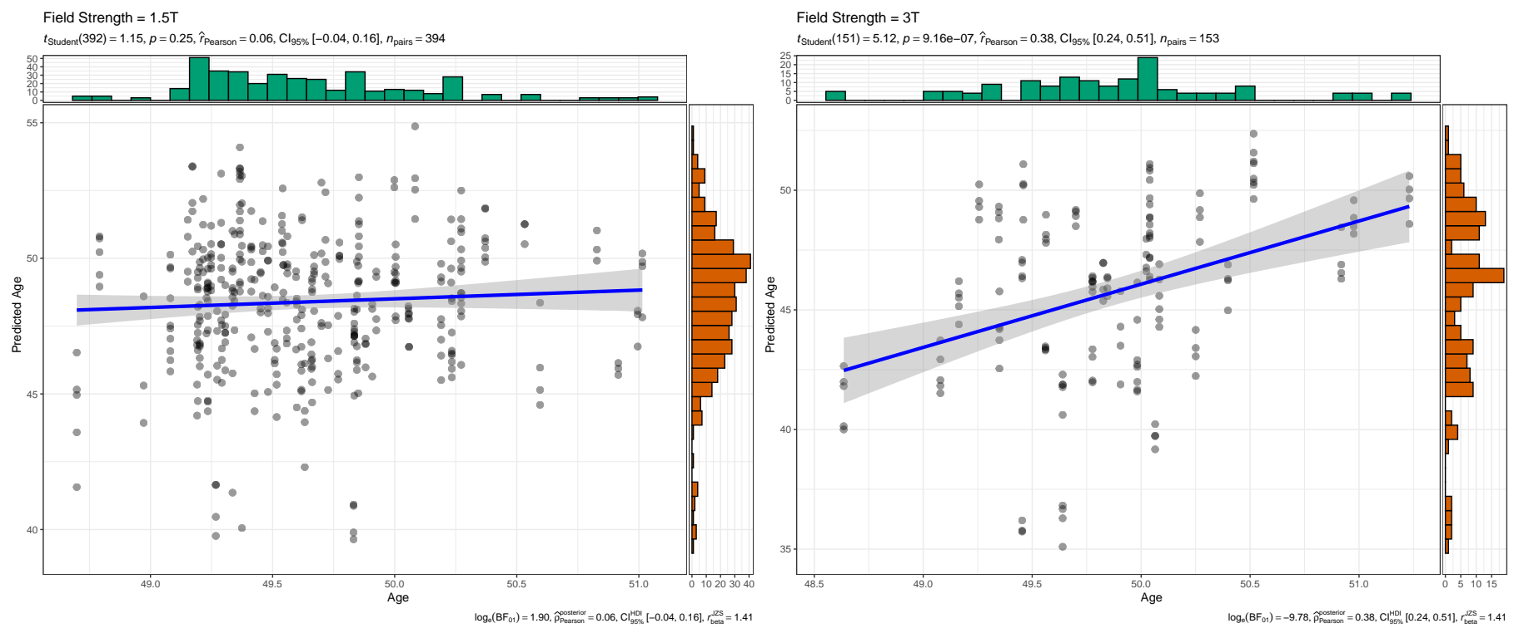
2. Putting brain age to the test
Concepts
Results
Conclusions
Testing 2 potential additional reasons for low corrspond.
Scan quality (diffuse results)
Field strength (bingo, but data only avail. for one sub.)
Hence, replicated in cross-sectional data
Korbmacher et al., 2023, Brain & Beh. (in press)

Slide 16
3. CONCLUSIONS

Slide 17
Summary
Concepts
Results
Conclusions
Fornix, perhaps inferior cerebellar peduncle & forceps minor (corpus collasum) are biommarker candidate regions
Requiers further validation
Imaging genetics requires large samples (just as GWAS)
Brain age is not ready for clinical application
Perhaps better to focus on true underlying data for biomarkers

Slide 18
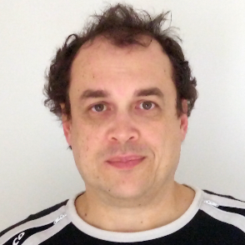
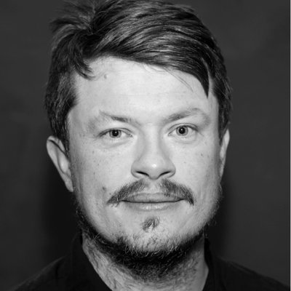
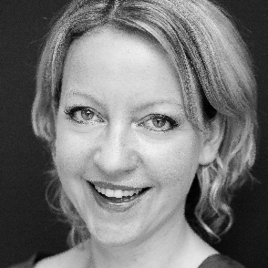
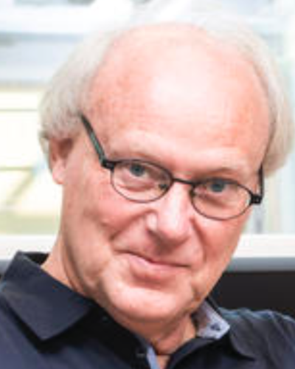

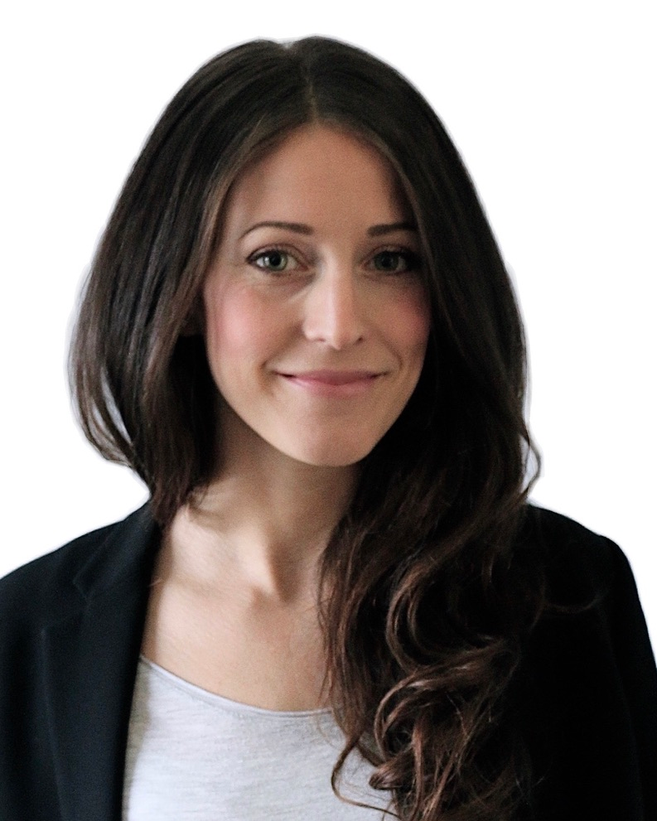
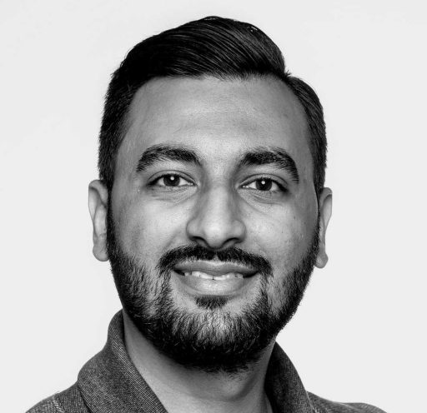
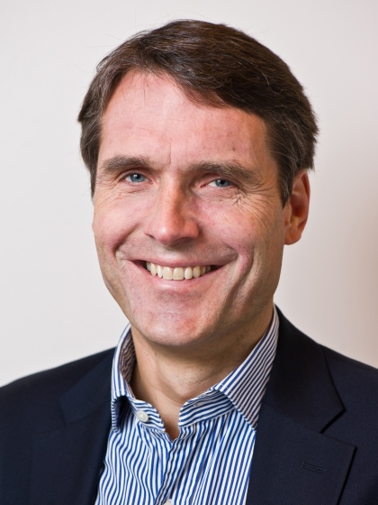
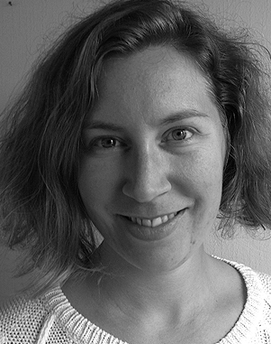
Ivan I. Maximov
Lars T. Westlye
Eli N. Eikefjord
Arvid Lundervold
Thank you!
Dennis van der Meer
Ann Marie de Lange
Dani Beck
Ole A. Andreassen
Tiril Gurholt

Slide 19
Questions?
How to contact me:
Email: Max.Korbmacher@hvl.no
Twitter: @KorbmacherMax

